Slide 1


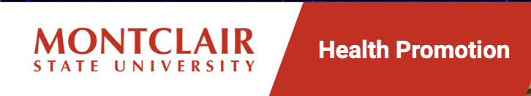
Health Promotion Analysis
INFO 495
Christopher Beals, Fatir Sheikh, Jacob Liebross, Damjan Dimitrovski
Sponsors: Marie Cascarano & John Han

Slide 2

Executive Summary
Analyzed student engagement using Tableau
Identified trends in visits, resources, and behavior
Found high repeat usage but low awareness
Provided recommendations to improve engagement

Slide 3



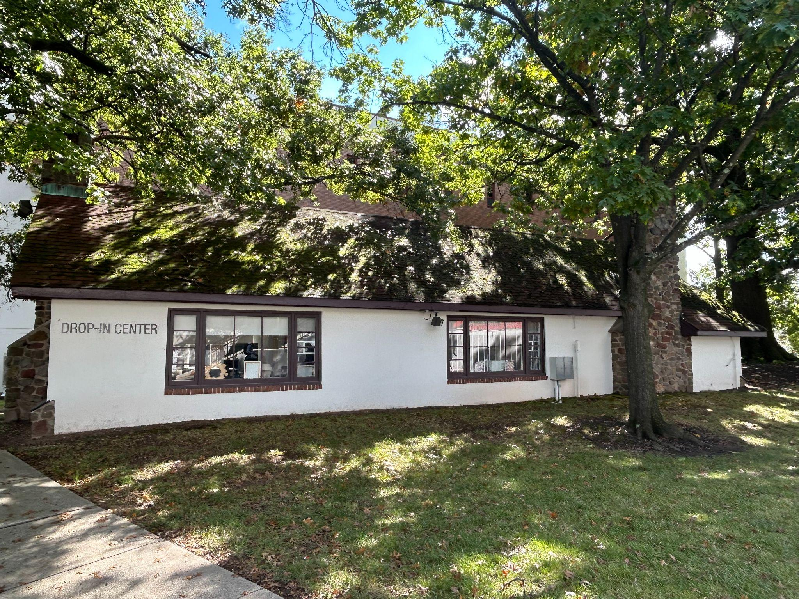
Project Description
Health Promotion collects Drop-In usage and event participation data
Data is unstructured and underutilized
Goal: extract insights to improve engagement and operations

Slide 4

Business Problem
Lack of structured insights limits ability to optimize services and increase student engagement

Slide 5
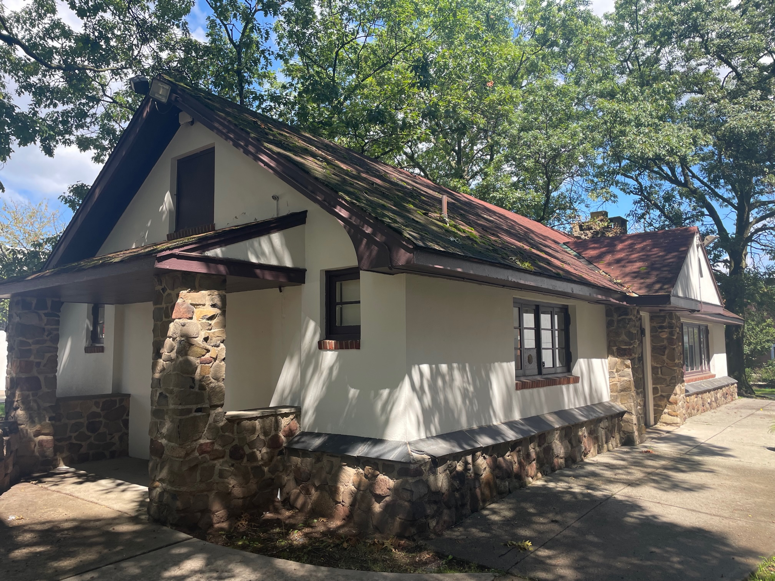
Analytical Problem
How can student engagement data be used to identify patterns and improve service delivery?

Slide 6
Stakeholders & Business Questions
Stakeholders:
Health Promotion Staff
Students
University Administration
Aligned Questions:
What resources should be prioritized? (Staff)
When should services be staffed? (Operations)
How can awareness be increased? (Marketing/Admin)
Which students are underrepresented? (University)

Slide 7
Stakeholders & Business Questions
Stakeholders:
Health Promotion Staff
Students
University Administration
Aligned Questions:
What resources should be prioritized? (Staff)
When should services be staffed? (Operations)
How can awareness be increased? (Marketing/Admin)
Which students are underrepresented? (University)

Slide 8

Business Benefits
Improve resource allocation
Identify high-demand resources (e.g., snacks, safer sex supplies) to better plan inventory
Optimize service hours and operations
Use engagement trends to align staffing with peak usage times
Increase student engagement and awareness
Identify gaps in participation, particularly among students who have never visited
Support targeted outreach strategies
Use insights (e.g., freshmen engagement trends) to improve programming and workshops
Demonstrate program effectiveness
High return rates indicate strong student value and can be used to promote services

Slide 9

Applying Data Analytics Lifecycle Methodologies
Business Understanding: Defined goals with Health Promotion
Data Understanding: Reviewed drop-in and event datasets
Data Preparation: Cleaned and structured multiple datasets
Analysis: Identified trends in usage and resource demand
Visualization: Built dashboard using Tableau

Slide 10
Data & Methodology
Data Sources
Drop-in center visit data (Fall & Spring)
Event attendance data (Engage platform)
Student survey responses (QR-based feedback)
Institutional Research data (aggregated student demographics)
Methodology
Data cleaning and integration across multiple datasets
Descriptive analytics and trend analysis
Frequency analysis of resource usage
Exploration of relationships between student attributes (grade level) and engagement

Slide 11
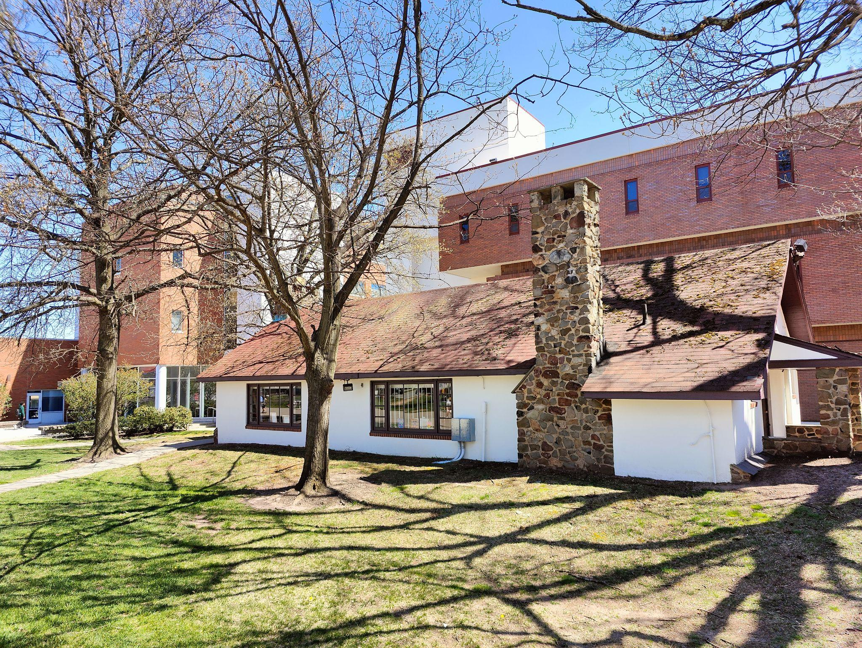
Data Challenges
Multiple datasets (Fall, Spring, Events)
Inconsistent formats
Limited demographic data
Required extensive cleaning

Slide 12


Analytics Methods and Tools
Tools Used
Tableau (data visualization)
Excel (data cleaning and preparation)
Methods Used
Descriptive analytics
Trend analysis
Frequency analysis

Slide 13

Research Methodology
Research Methodology
Focused on analyzing real-world student engagement data
Applied structured data cleaning and transformation
Used visualization to identify patterns and trends
Followed a data analytics lifecycle approach (CRISP-DM)

Slide 14

Risk Assessment
Risks:
Delay in receiving Institutional Research Data
Data inconsistency across excel files
Limitations in demographic data
Mitigation:
Standardized Data Cleaning Process
Focused Analysis on Available Data
Integrated Additional Data Provided

Slide 15
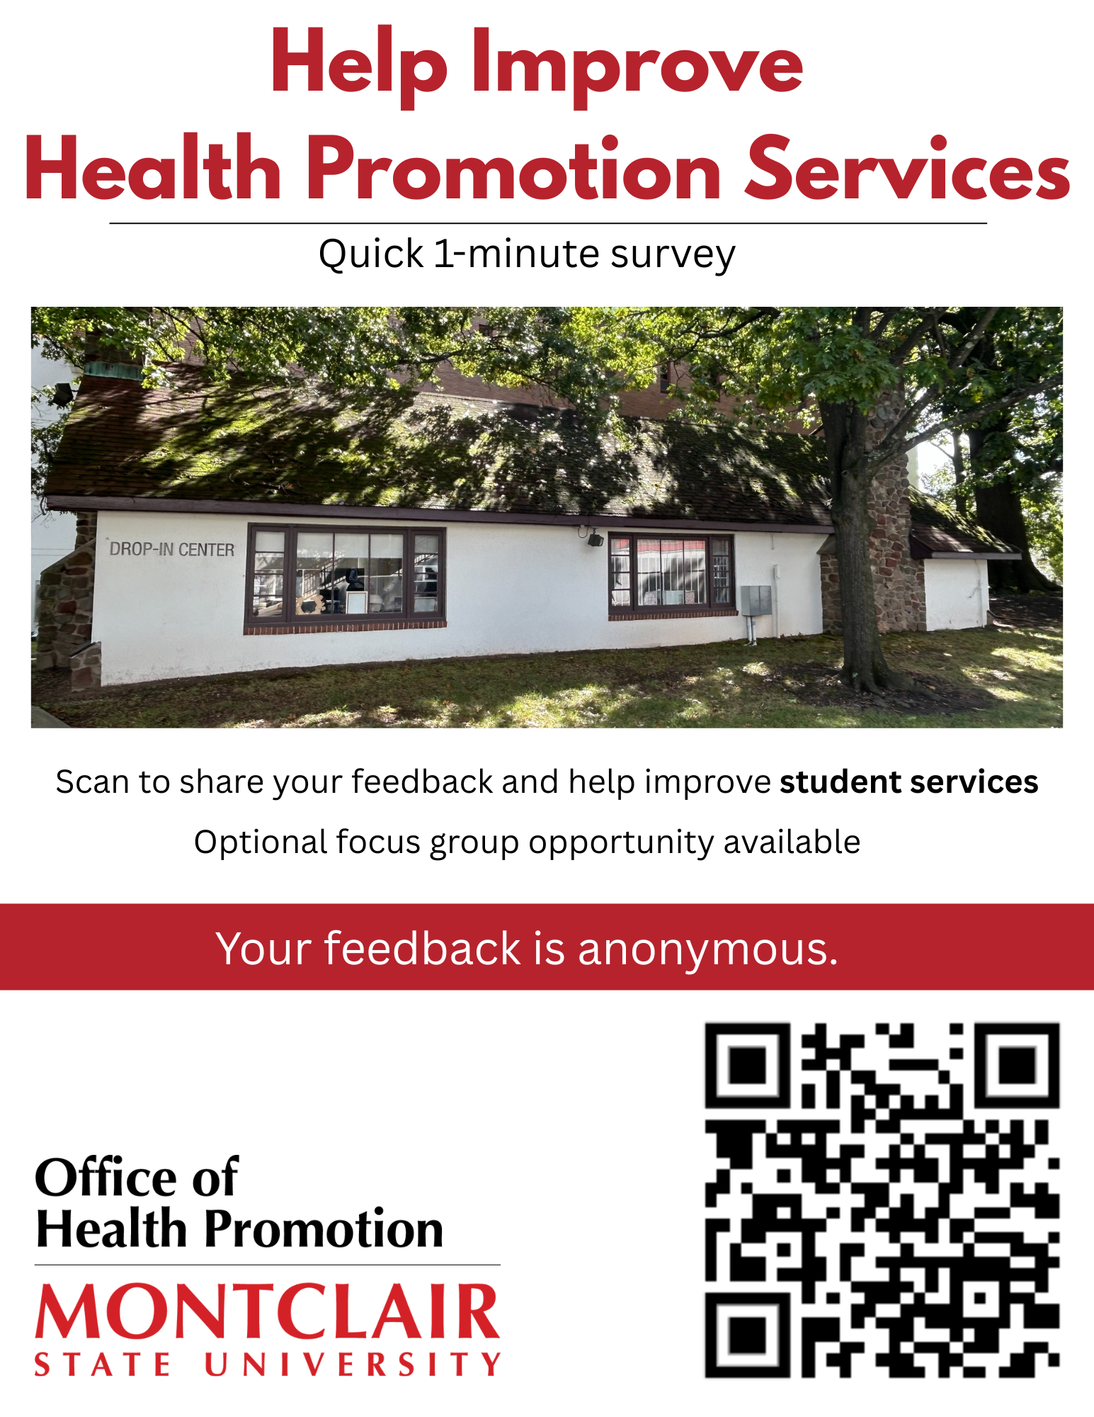


Slide 16
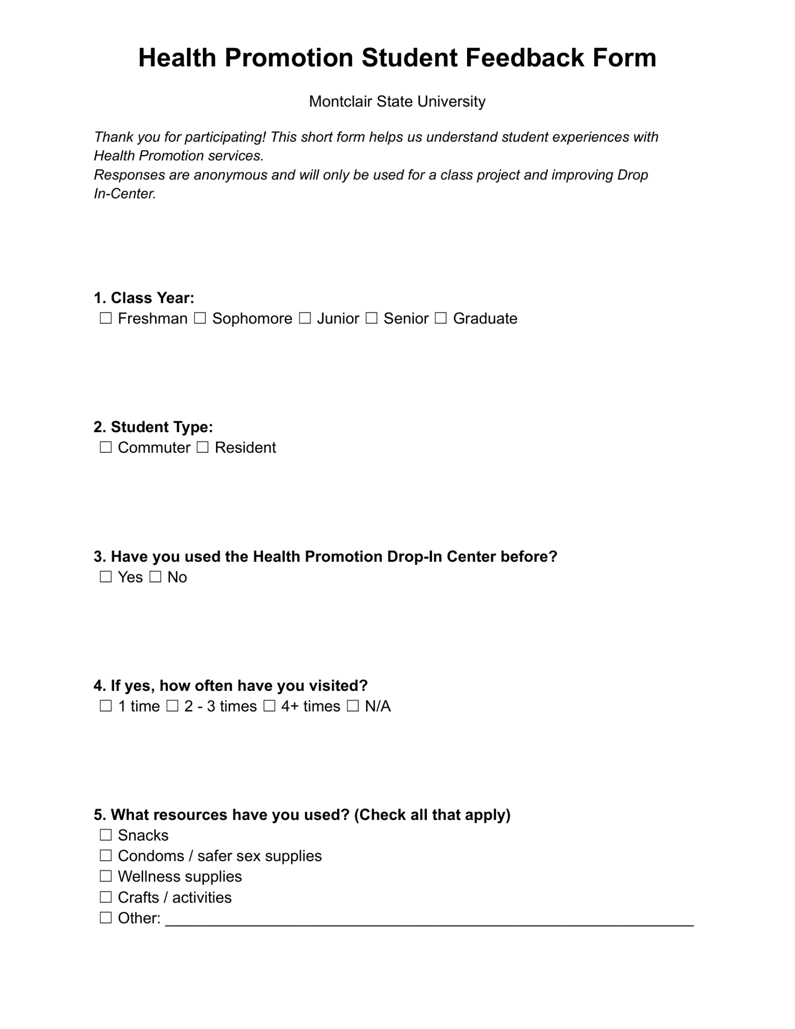
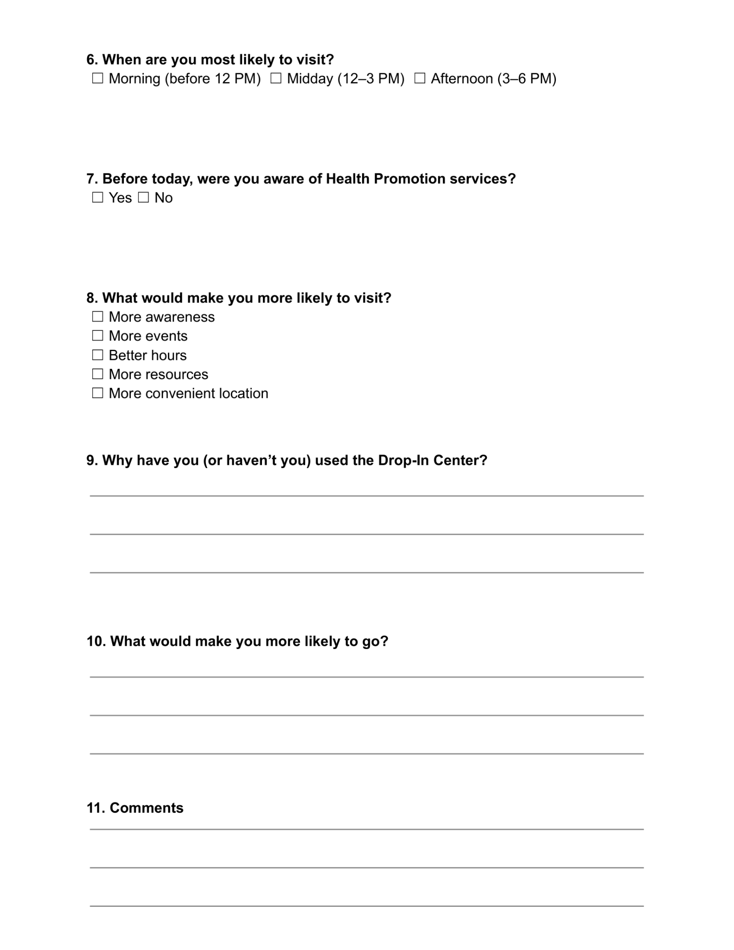
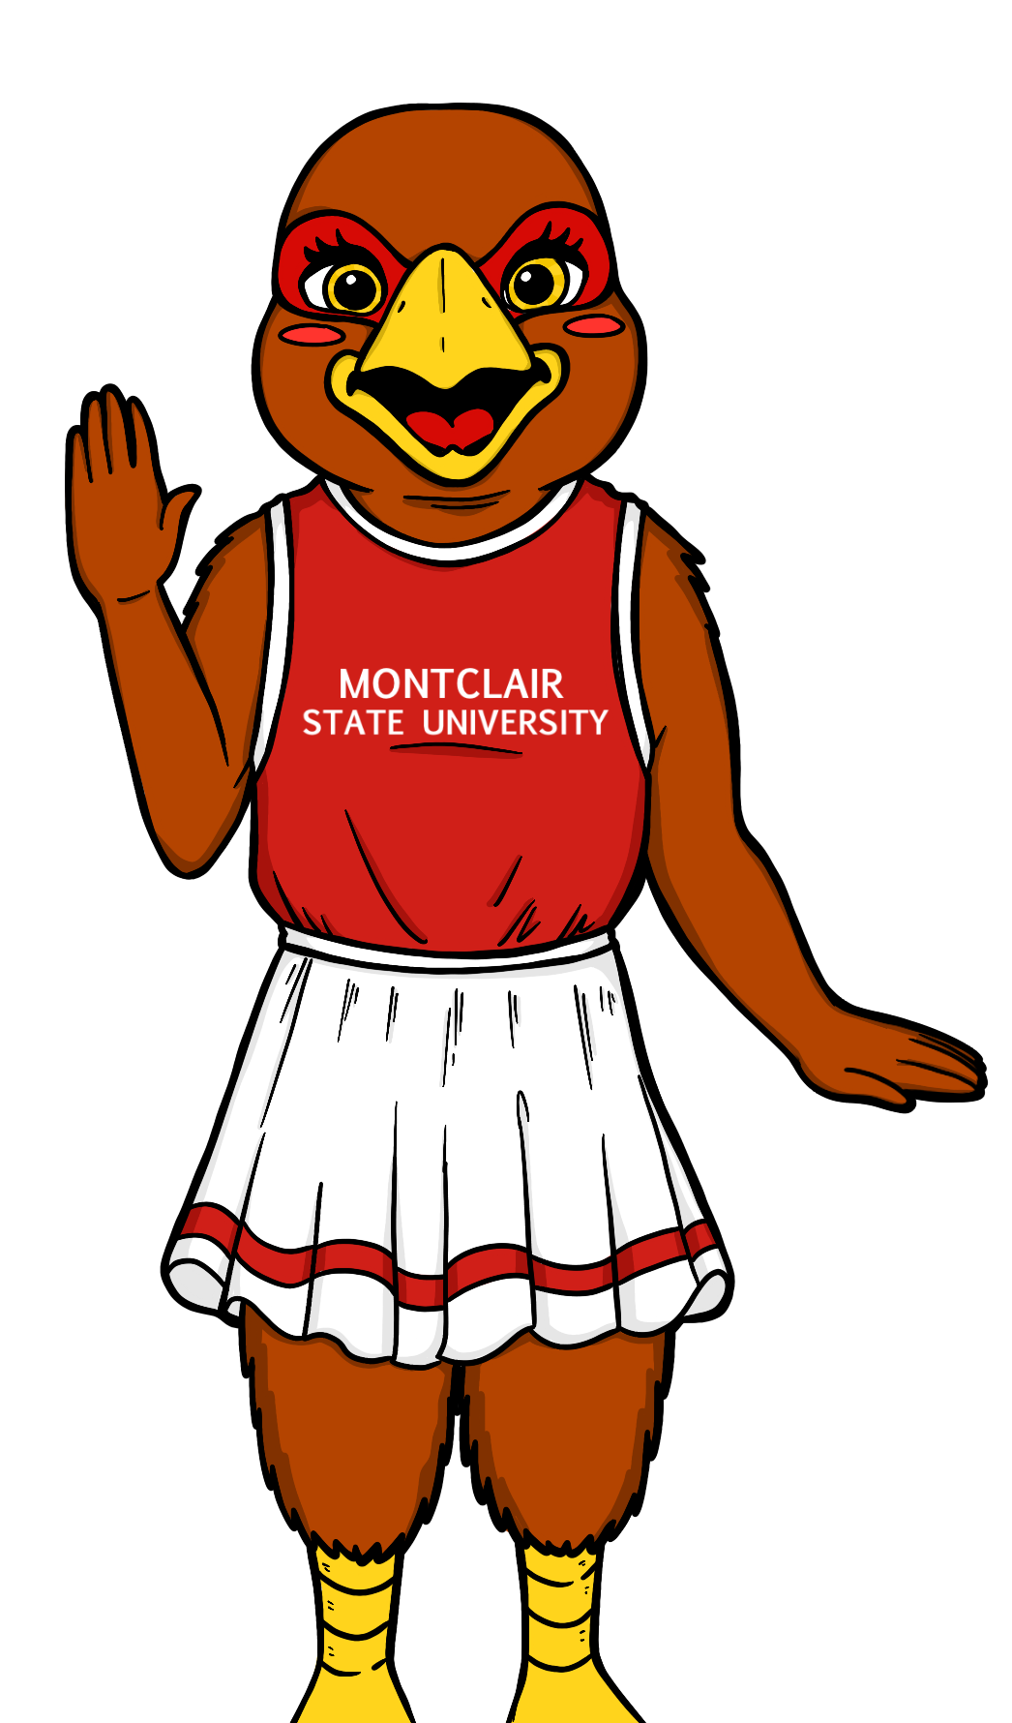

Slide 17
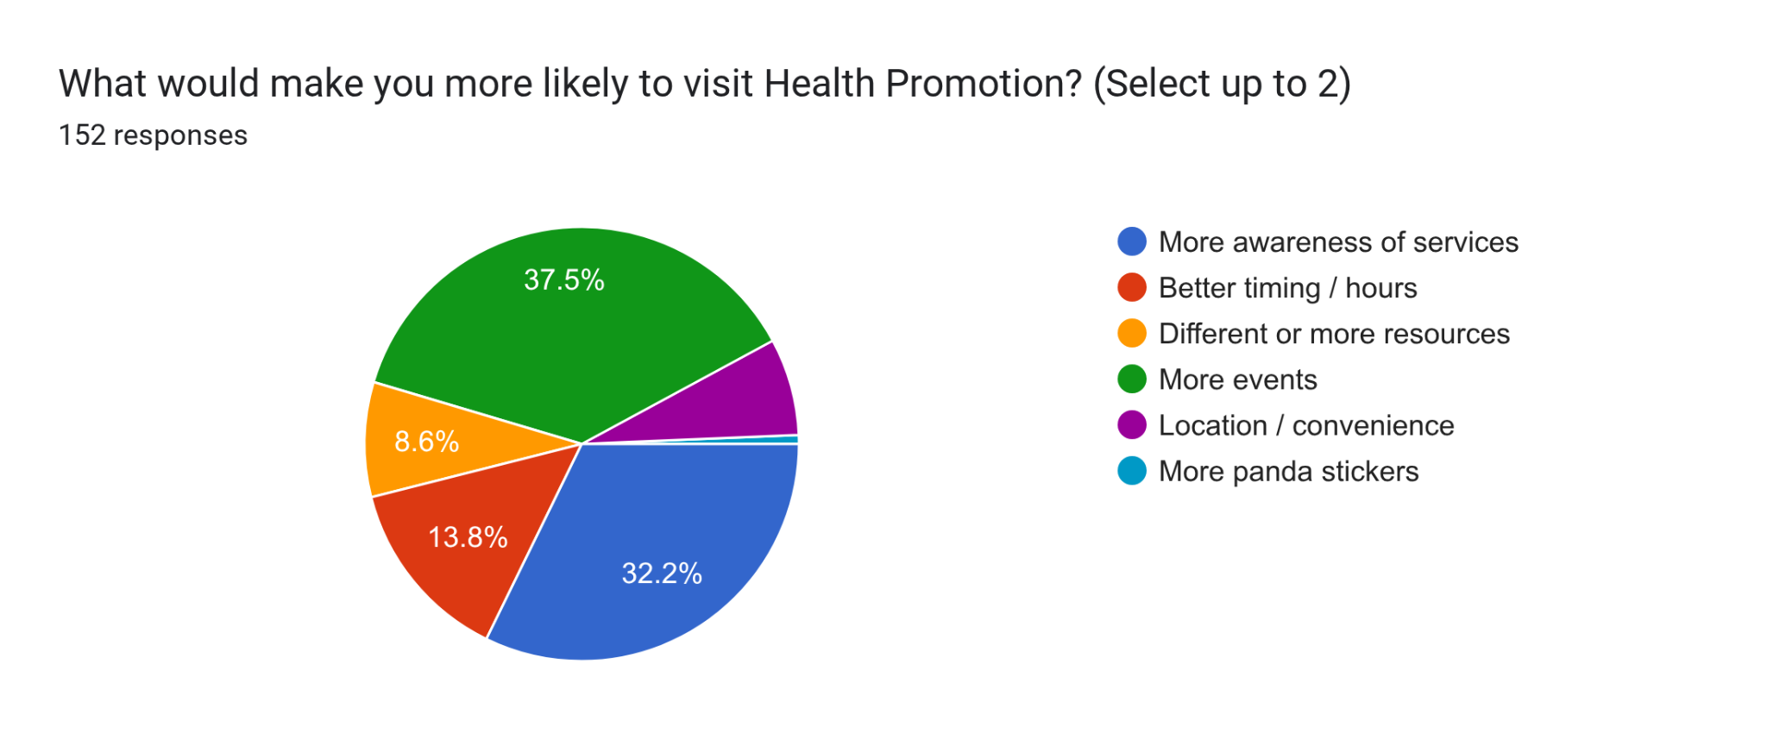
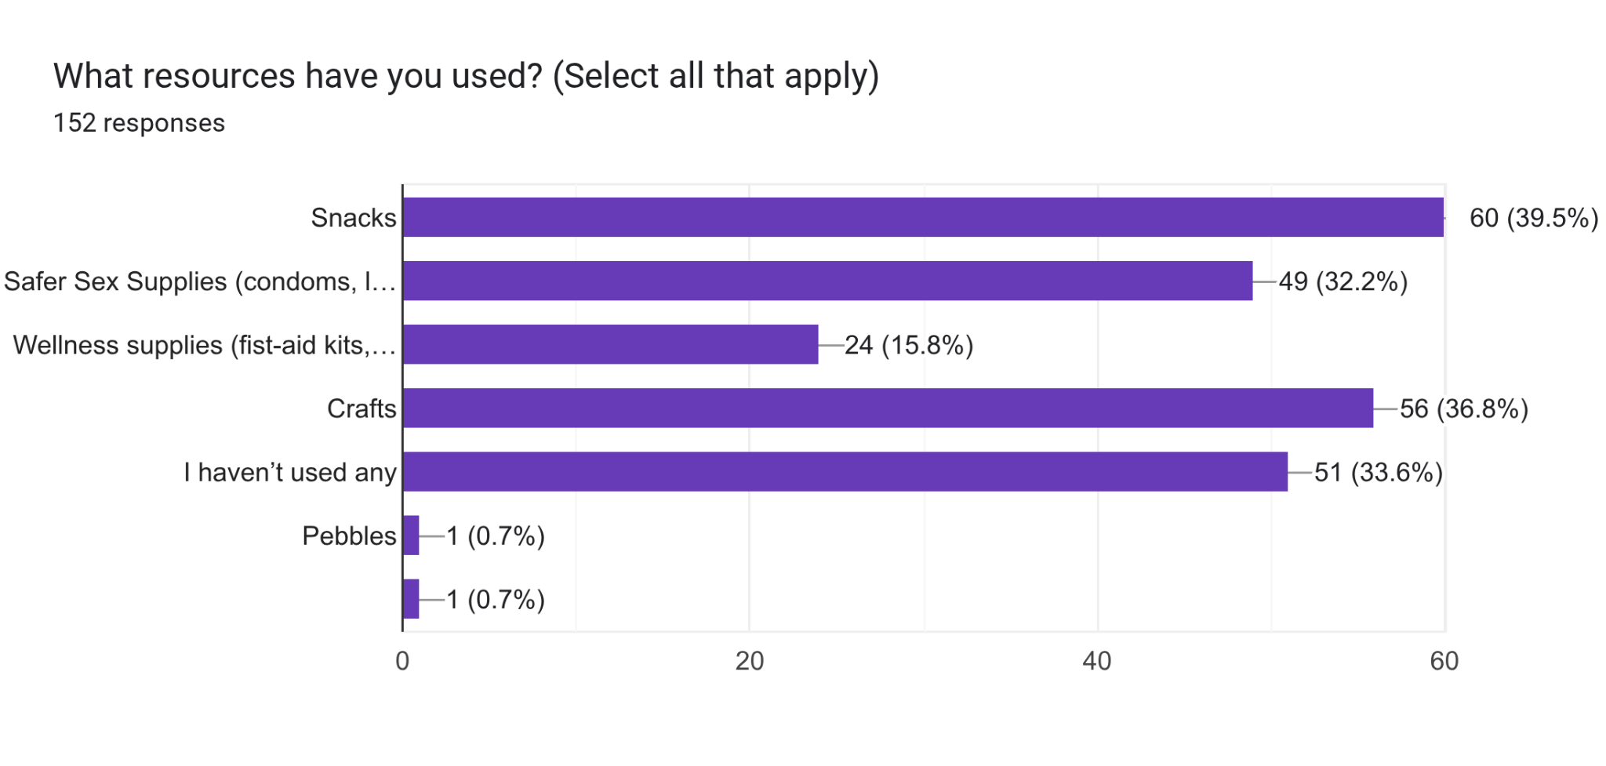
Survey Insights
~44% have never visited → awareness gap
Strong repeat usage → high satisfaction
Peak time = 1–3 PM → operational insight
Crafts & snacks most used → engagement drivers
Students want more events & awareness

Slide 18

Qualitative Research
Conducting focus groups with students
Comparing engagement
Goal: understand barriers to participation
“Hidden Gem on Campus, Cute Space and Interesting Events” - Focus Group Participant

Slide 19
Focus Group
Key Themes
Low awareness of Health Promotion services (mentioned 6+ times)
Engagement driven by social behavior (students attend with friends)
Higher engagement during freshman year
Positive experiences among users (friendly staff, welcoming environment)
Strong interest in events and interactive activities
Barriers to Engagement
Lack of awareness and visibility
Limited outreach and marketing
Unclear location / building confusion
Lack of perceived need
Timing constraints

Slide 20
Focus Group
Opportunities for Improvement
Increase social media promotion and outreach
Expand event-based programming
Improve visibility of the location (signage, branding)
Promote available resources more clearly online
Create more interactive and social experiences
Key Quotes
“Not many students know about Health Promotion.”
“I didn’t even know it existed.”
“I came with friends, it’s more of a group activity.”
“Would go if something caught my attention.”

Slide 21

Demographic Insights
Class year trends
Gender
Ethnicity
Commuter / Resident

Slide 22
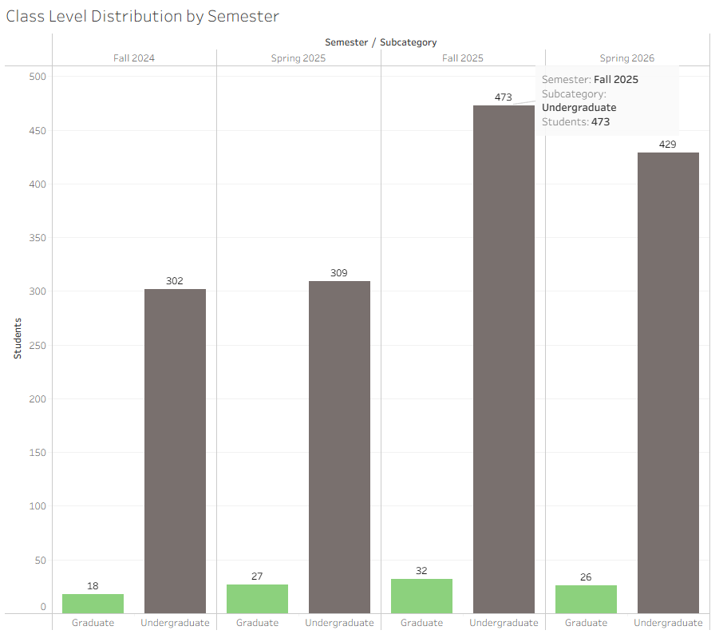

Slide 23
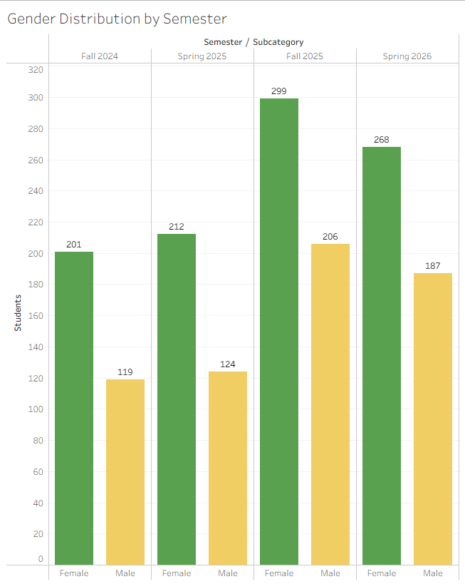

Slide 24
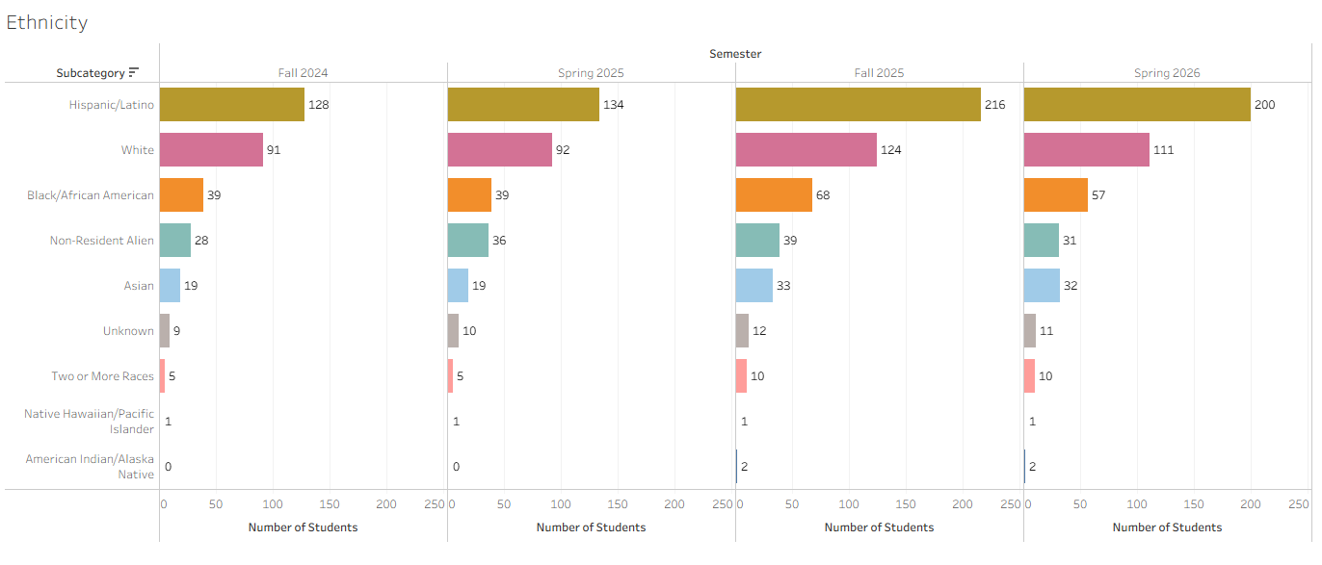

Slide 25
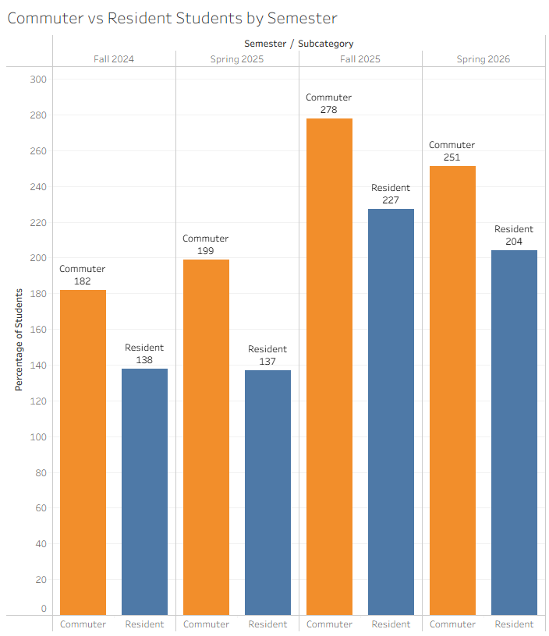

Slide 26

Key Resource Insights
High return rate
Low awareness
Demand concentrated in few resources
Midday peak usage
Students want more events

Slide 27
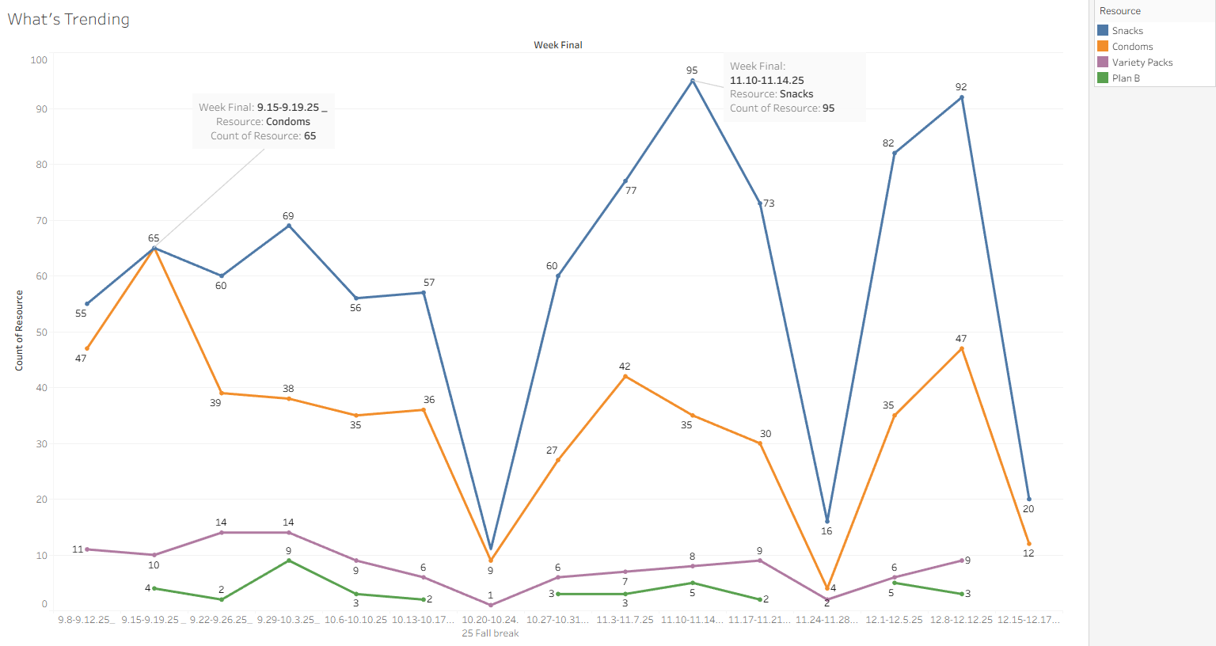
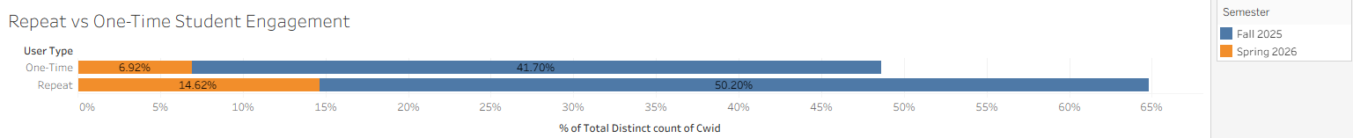

Slide 28
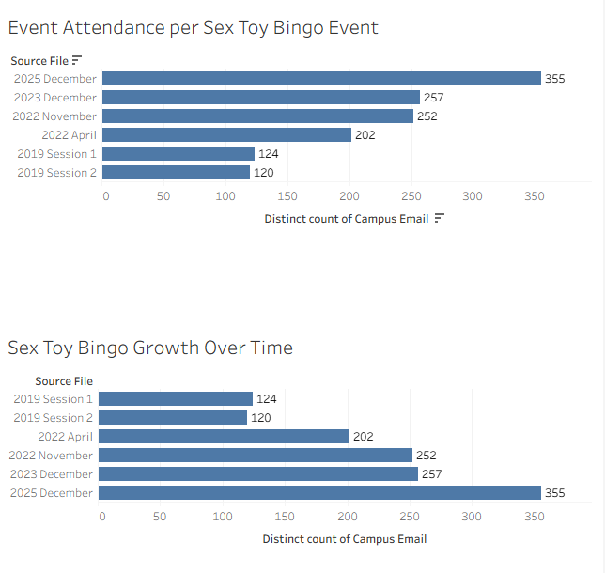
Event
Insights

Slide 29
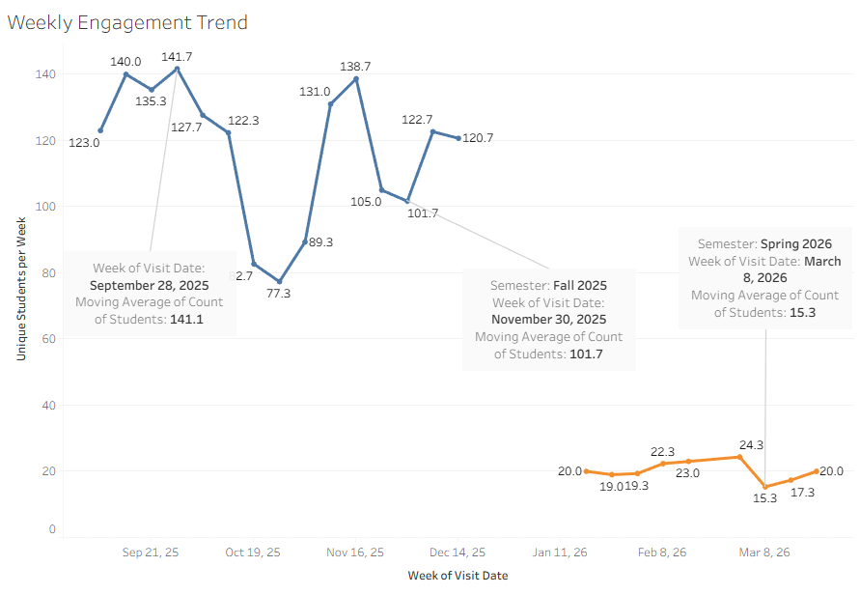
Moving Average of Student Drop In-Center Visits per week

Slide 30

Key Insights
High return rate
Low awareness
Demand concentrated in few resources
Midday peak usage
Students want more events

Slide 31
Benchmarking & Industry Context
Most universities offer health promotion or wellness centers with similar services (peer education, wellness resources, Drop-In support)
These programs typically focus on accessibility, outreach, and student engagement initiatives
However, there is limited publicly available data on detailed usage analytics or demographic engagement patterns
This highlights the value of our analysis in providing data-driven insights that are not commonly published

Slide 32

Recommendations
Increase awareness of services
Expand event-based programming
Focus on interactive/social engagement
Optimize midday staffing

Slide 33
Conclusion
This project provides data-driven insights to improve student engagement and optimize Health Promotion services.

Slide 34
Thank You

